Slide 1

MONGO DB OPERATORS
NAME : VARADHA . N
UID : 161101
MAIL ID : varadha.nair@ust.com
DATE : 10/12/2020

Slide 2
query selector

Slide 3
COMPARISON OPERATOR
> use movieData
switched to db movieData
> show collections
movies
sales
users
> db.users.find({age:{$gt:19}}).pretty()
{
"_id" : ObjectId("5fd31480873d119bc0e18249"),
"name" : "Sandya",
"age" : 25,
"power" : "Young wolf"
}
{
"_id" : ObjectId("5fd314ba873d119bc0e1824b"),
"name" : "DoluBolu",
"age" : 28,

Slide 4
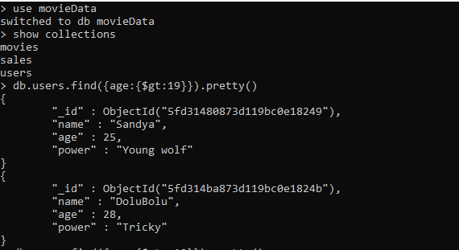

Slide 5
> db.users.find({age:{$gte:19}}).pretty()
{
"_id" : ObjectId("5fd30fa1873d119bc0e18247"),
"name" : "aiswarya",
"age" : 19
}
{
"_id" : ObjectId("5fd31480873d119bc0e18249"),
"name" : "Sandya",
"age" : 25,
"power" : "Young wolf"
}
{
"_id" : ObjectId("5fd314ba873d119bc0e1824a"),
"name" : "ChottaBeam",
"age" : 19,
"power" : null
}
{
"_id" : ObjectId("5fd314ba873d119bc0e1824b"),
"name" : "DoluBolu",
"age" : 28,
"power" : "Tricky"
}
>

Slide 6
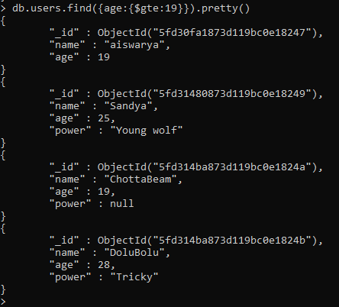

Slide 7
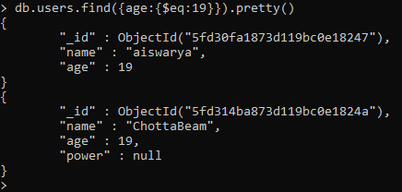
> db.users.find({age:{$eq:19}}).pretty()
{
"_id" : ObjectId("5fd30fa1873d119bc0e18247"),
"name" : "aiswarya",
"age" : 19
}
{
"_id" : ObjectId("5fd314ba873d119bc0e1824a"),
"name" : "ChottaBeam",
"age" : 19,
"power" : null
}
>

Slide 8
> db.users.find({age:{$in:[19,25]}}).pretty()
{
"_id" : ObjectId("5fd30fa1873d119bc0e18247"),
"name" : "aiswarya",
"age" : 19
}
{
"_id" : ObjectId("5fd31480873d119bc0e18249"),
"name" : "Sandya",
"age" : 25,
"power" : "Young wolf"
}
{
"_id" : ObjectId("5fd314ba873d119bc0e1824a"),
"name" : "ChottaBeam",
"age" : 19,
"power" : null
}
>

Slide 9
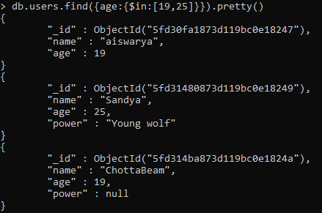

Slide 10
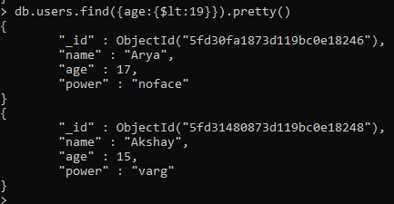
db.users.find({age:{$lt:19}}).pretty()
{
"_id" : ObjectId("5fd30fa1873d119bc0e18246"),
"name" : "Arya",
"age" : 17,
"power" : "noface"
}
{
"_id" : ObjectId("5fd31480873d119bc0e18248"),
"name" : "Akshay",
"age" : 15,
"power" : "varg"
}

Slide 11
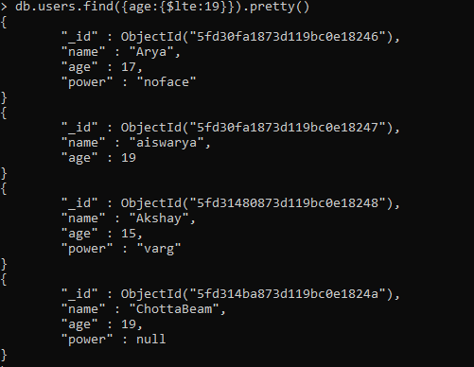
> db.users.find({age:{$lte:19}}).pretty()
{
"_id" : ObjectId("5fd30fa1873d119bc0e18246"),
"name" : "Arya",
"age" : 17,
"power" : "noface"
}
{
"_id" : ObjectId("5fd30fa1873d119bc0e18247"),
"name" : "aiswarya",
"age" : 19
}
{
"_id" : ObjectId("5fd31480873d119bc0e18248"),
"name" : "Akshay",
"age" : 15,
"power" : "varg"
}
{
"_id" : ObjectId("5fd314ba873d119bc0e1824a"),
"name" : "ChottaBeam",
"age" : 19,
"power" : null
}
>

Slide 12
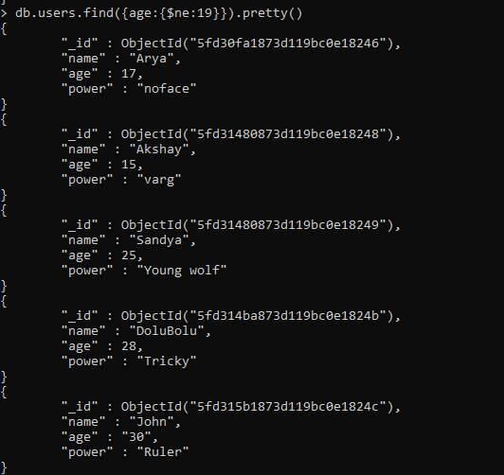
> db.users.find({age:{$ne:19}}).pretty()
{
"_id" : ObjectId("5fd30fa1873d119bc0e18246"),
"name" : "Arya",
"age" : 17,
"power" : "noface"
}
{
"_id" : ObjectId("5fd31480873d119bc0e18248"),
"name" : "Akshay",
"age" : 15,
"power" : "varg"
}
{
"_id" : ObjectId("5fd31480873d119bc0e18249"),
"name" : "Sandya",
"age" : 25,
"power" : "Young wolf"
}
{
"_id" : ObjectId("5fd314ba873d119bc0e1824b"),
"name" : "DoluBolu",
"age" : 28,
"power" : "Tricky"
}
{
"_id" : ObjectId("5fd315b1873d119bc0e1824c"),
"name" : "John",
"age" : "30",
"power" : "Ruler"
}

Slide 13
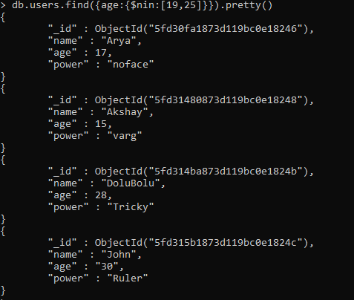
> db.users.find({age:{$nin:[19,25]}}).pretty()
{
"_id" : ObjectId("5fd30fa1873d119bc0e18246"),
"name" : "Arya",
"age" : 17,
"power" : "noface"
}
{
"_id" : ObjectId("5fd31480873d119bc0e18248"),
"name" : "Akshay",
"age" : 15,
"power" : "varg"
}
{
"_id" : ObjectId("5fd314ba873d119bc0e1824b"),
"name" : "DoluBolu",
"age" : 28,
"power" : "Tricky"
}
{
"_id" : ObjectId("5fd315b1873d119bc0e1824c"),
"name" : "John",
"age" : "30",
"power" : "Ruler"
}
>

Slide 14
LOGICAL OPERATORS

Slide 15
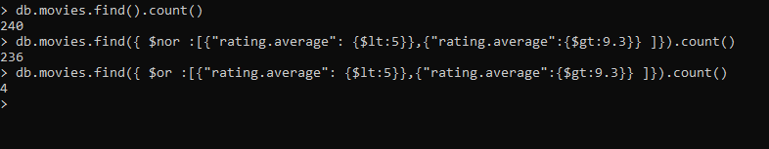
OR & nor OPERATORS
> db.movies.find().count()
240
> db.movies.find({ $nor :[{"rating.average": {$lt:5}},{"rating.average":{$gt:9.3}} ]}).count()
236
> db.movies.find({ $or :[{"rating.average": {$lt:5}},{"rating.average":{$gt:9.3}} ]}).count()
4
>

Slide 16
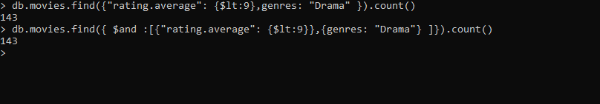
AND OPERATORS
> db.movies.find({"rating.average": {$lt:9},genres: "Drama" }).count()
143
> db.movies.find({ $and :[{"rating.average": {$lt:9}},{genres: "Drama"} ]}).count()
143
>

Slide 17

> db.movies.find({$and : [{genres: "Drama"},{genres:"Horror"}] }).count()
17
> db.movies.find({genres: "Drama",genres:"Horror"}).count()
23
>

Slide 18
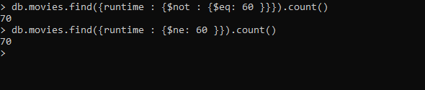
NOT OPERATORS
> db.movies.find({runtime : {$not : {$eq: 60 }}}).count()
70
> db.movies.find({runtime : {$ne: 60 }}).count()
70
>

Slide 19
ELEMENT OPERATIONS

Slide 20
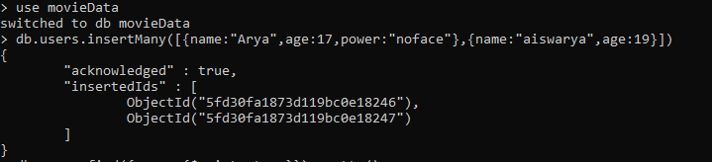
> use movieData
switched to db movieData
> db.users.insertMany([{name:"Arya",age:17,power:"noface"},{name:"aiswarya",age:19}])
{
"acknowledged" : true,
"insertedIds" : [
ObjectId("5fd30fa1873d119bc0e18246"),
ObjectId("5fd30fa1873d119bc0e18247")
]
}

Slide 21
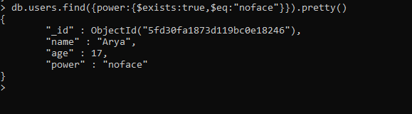
> db.users.find({power:{$exists:true,$eq:"noface"}}).pretty()
{
"_id" : ObjectId("5fd30fa1873d119bc0e18246"),
"name" : "Arya",
"age" : 17,
"power" : "noface"
}
>

Slide 22
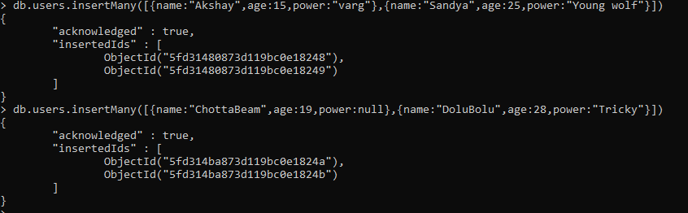
> db.users.insertMany([{name:"Akshay",age:15,power:"varg"},{name:"Sandya",age:25,power:"Young wolf"}])
{
"acknowledged" : true,
"insertedIds" : [
ObjectId("5fd31480873d119bc0e18248"),
ObjectId("5fd31480873d119bc0e18249")
]
}
> db.users.insertMany([{name:"ChottaBeam",age:19,power:null},{name:"DoluBolu",age:28,power:"Tricky"}])
{
"acknowledged" : true,
"insertedIds" : [
ObjectId("5fd314ba873d119bc0e1824a"),
ObjectId("5fd314ba873d119bc0e1824b")
]
}
>

Slide 23
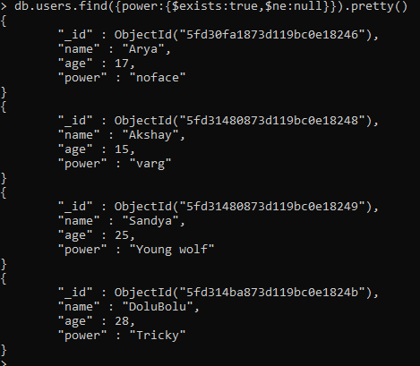
> db.users.find({power:{$exists:true,$ne:null}}).pretty()
{
"_id" : ObjectId("5fd30fa1873d119bc0e18246"),
"name" : "Arya",
"age" : 17,
"power" : "noface"
}
{
"_id" : ObjectId("5fd31480873d119bc0e18248"),
"name" : "Akshay",
"age" : 15,
"power" : "varg"
}
{
"_id" : ObjectId("5fd31480873d119bc0e18249"),
"name" : "Sandya",
"age" : 25,
"power" : "Young wolf"
}
{
"_id" : ObjectId("5fd314ba873d119bc0e1824b"),
"name" : "DoluBolu",
"age" : 28,
"power" : "Tricky"
}

Slide 24

> db.users.insertOne({name:"John",age:"30",power:"Ruler"})
{
"acknowledged" : true,
"insertedId" : ObjectId("5fd315b1873d119bc0e1824c")
}
>

Slide 25
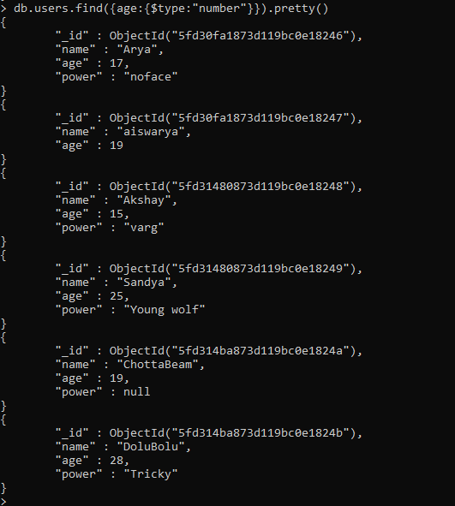

Slide 26
EVALUATION OPERATIONS

Slide 27

> db.sales.find({$expr : {$gt:["volume","target"]}})
{ "_id" : ObjectId("5fd31f47873d119bc0e1824d"), "volume" : 100, "target" : 120 }
{ "_id" : ObjectId("5fd31f47873d119bc0e1824e"), "volume" : 89, "target" : 80 }
{ "_id" : ObjectId("5fd31f47873d119bc0e1824f"), "volume" : 200, "target" : 177 }
>

Slide 28
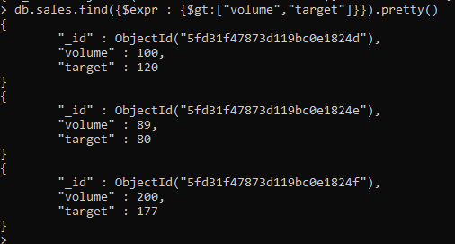
> db.sales.find({$expr : {$gt:["volume","target"]}}).pretty()
{
"_id" : ObjectId("5fd31f47873d119bc0e1824d"),
"volume" : 100,
"target" : 120
}
{
"_id" : ObjectId("5fd31f47873d119bc0e1824e"),
"volume" : 89,
"target" : 80
}
{
"_id" : ObjectId("5fd31f47873d119bc0e1824f"),
"volume" : 200,
"target" : 177
}
>

Slide 29
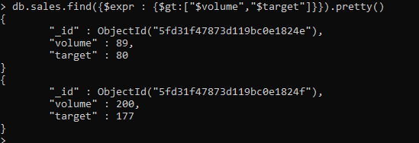
> db.sales.find({$expr : {$gt:["$volume","$target"]}}).pretty()
{
"_id" : ObjectId("5fd31f47873d119bc0e1824e"),
"volume" : 89,
"target" : 80
}
{
"_id" : ObjectId("5fd31f47873d119bc0e1824f"),
"volume" : 200,
"target" : 177
}
>

Slide 30

> db.movies.find({"officialSite":{$regex:/cbs/}}).count()
23
>

Slide 31
ARRAY OPERATIONS

Slide 32
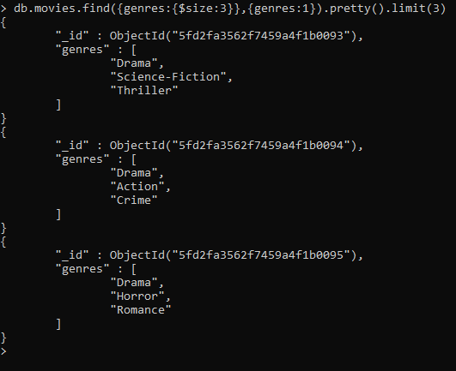
> db.movies.find({genres:{$size:3}},{genres:1}).pretty().limit(3)
{
"_id" : ObjectId("5fd2fa3562f7459a4f1b0093"),
"genres" : [
"Drama",
"Science-Fiction",
"Thriller"
]
}
{
"_id" : ObjectId("5fd2fa3562f7459a4f1b0094"),
"genres" : [
"Drama",
"Action",
"Crime"
]
}
{
"_id" : ObjectId("5fd2fa3562f7459a4f1b0095"),
"genres" : [
"Drama",
"Horror",
"Romance"
]
}
>

Slide 33
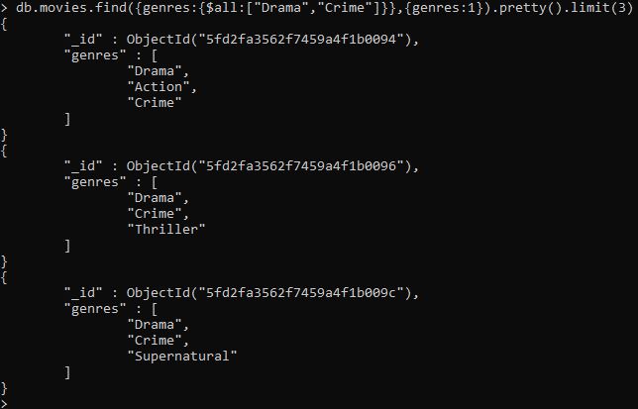
> db.movies.find({genres:{$all:["Drama","Crime"]}},{genres:1}).pretty().limit(3)
{
"_id" : ObjectId("5fd2fa3562f7459a4f1b0094"),
"genres" : [
"Drama",
"Action",
"Crime"
]
}
{
"_id" : ObjectId("5fd2fa3562f7459a4f1b0096"),
"genres" : [
"Drama",
"Crime",
"Thriller"
]
}
{
"_id" : ObjectId("5fd2fa3562f7459a4f1b009c"),
"genres" : [
"Drama",
"Crime",
"Supernatural"
]
}
>

Slide 34
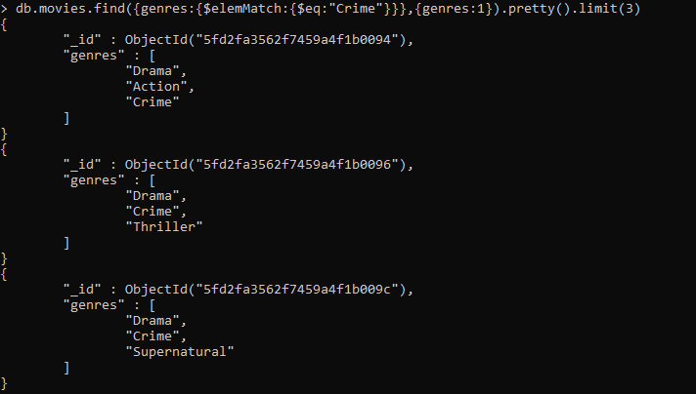
> db.movies.find({genres:{$elemMatch:{$eq:"Crime"}}},{genres:1}).pretty().limit(3)
{
"_id" : ObjectId("5fd2fa3562f7459a4f1b0094"),
"genres" : [
"Drama",
"Action",
"Crime"
]
}
{
"_id" : ObjectId("5fd2fa3562f7459a4f1b0096"),
"genres" : [
"Drama",
"Crime",
"Thriller"
]
}
{
"_id" : ObjectId("5fd2fa3562f7459a4f1b009c"),
"genres" : [
"Drama",
"Crime",
"Supernatural"
]
}
>

Slide 35
AGGREGATION PIPELINE OPERATIONS

Slide 36
> db.sales.find({$expr :{$cond:{if:{$gte:["$volume",190]},then : {$subtract:["$target",10]},else : {$multiply : ["$target",2]}}}}).pretty()
{
"_id" : ObjectId("5fd31f47873d119bc0e1824d"),
"volume" : 100,
"target" : 120
}
{
"_id" : ObjectId("5fd31f47873d119bc0e1824e"),
"volume" : 89,
"target" : 80
}
{
"_id" : ObjectId("5fd31f47873d119bc0e1824f"),
"volume" : 200,
"target" : 177
}
>

Slide 37
